Slide 1

Graphic Tips
《GPU Gems 3》Introduction

Slide 2
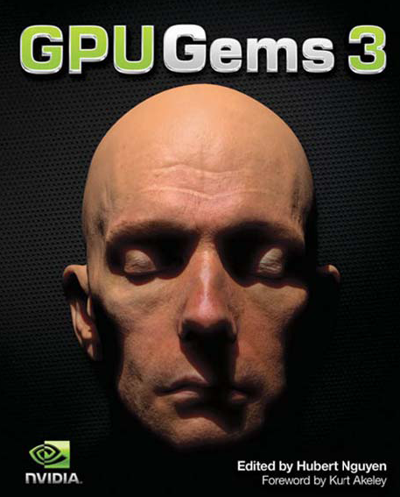
GPU Gems 3
Author: Hubert Nguyen
  Manager of Developer Education at NVIDIA.
  a graphics engineer.
nVidia Corp
Published in Aug, 2007

Slide 3
GPU Gems 3
Part | Chapter | Total chapter | Total pages
Geometry | 1~7 | 7 | 150
Light & shadow | 8~13 | 6 | 135
Rendering | 14~20 | 7 | 190
Image effects | 21~28 | 8 | 130
Physics simulation | 29~34 | 6 | 160
GPU computing | 35~41 | 7 | 140

Slide 4
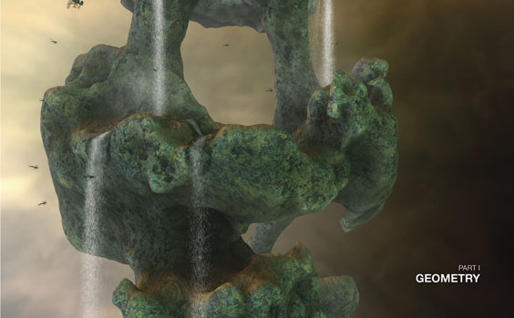
1. Geometry
GS
Instance
Mesh
Animation

Slide 5
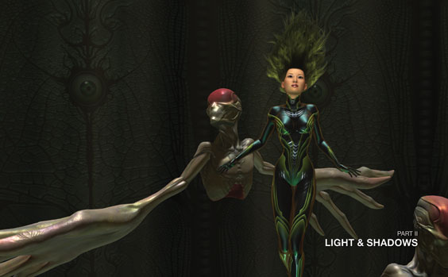
2. Light & shadow
Global illumination
Shadow volume
Shadow map
Ambient occlusion
Post Processing

Slide 6
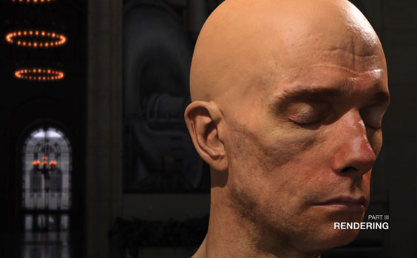
3. Rendering
Skin
Multi-reflection
Sampling

Slide 7

4. Image Effects
Imposter
Sampling
Post processing

Slide 8
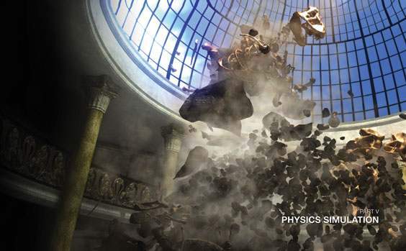
5. Physics simulation
运动
碰撞
流体

Slide 9
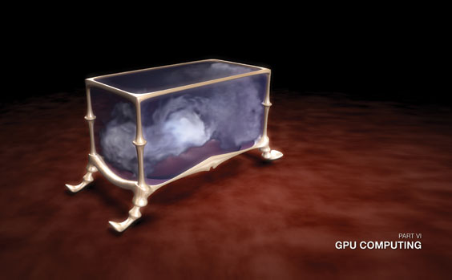
6. GPU computing
加密解密
噪声
CUDA

Slide 10

Rendering System
Application

Slide 11
课程目标
分析一个具体的基于渲染系统的应用程序的构成
渲染系统各个重要组成部分的简单介绍

Slide 12
应用程序的结构分析
  动态分析
  静态分析

Slide 13
Application Structure
从应用程序运行的角度分析 （动态分析）
  Hardware
  Engine
  Application

Slide 14
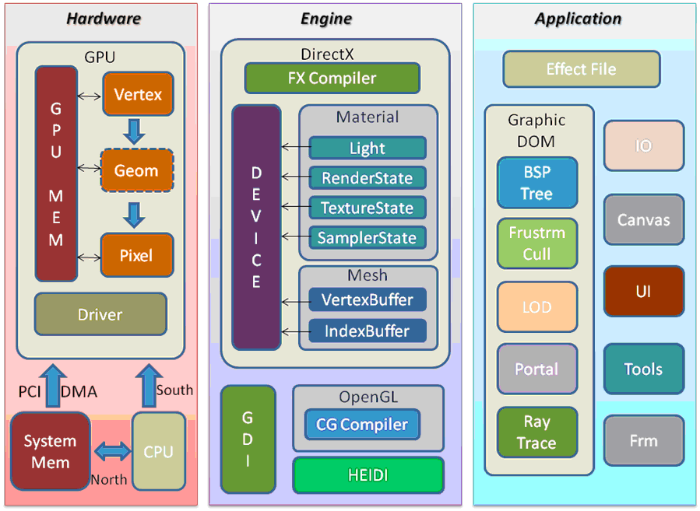

Slide 15
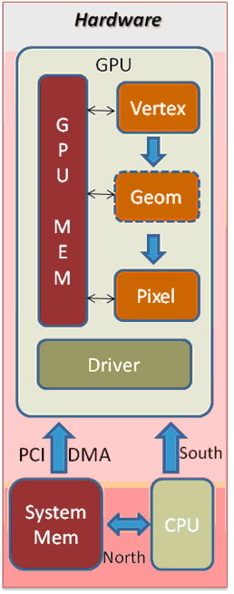
Hardware
GPU
  Shaders
  GPU memory
  Driver
CPU
System Memory
Bus

Slide 16
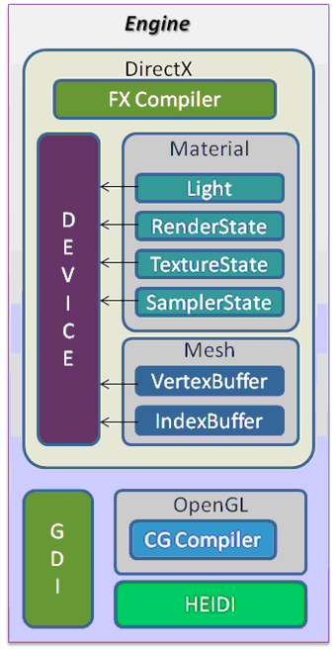
Engine
DirectX
  Device (GPU)
  Mesh
  Fixed pipeline component
  Programmable pipeline
OpenGL
HEIDI
GDI

Slide 17
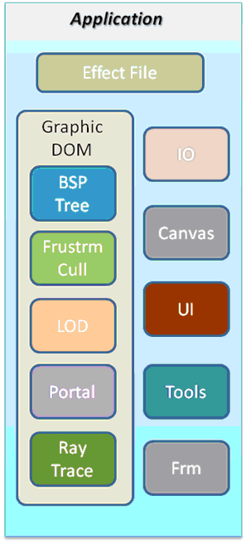
Application
Effect file
  Programmable pipeline
Graphic DOM
  BSP tree
  Culling technique
Other componets
  Viewports
  IO
  ……

Slide 18
Application Structure
应用程序本身结构分析 （静态分析）
  Kernel
  Components
  Plugins

Slide 19
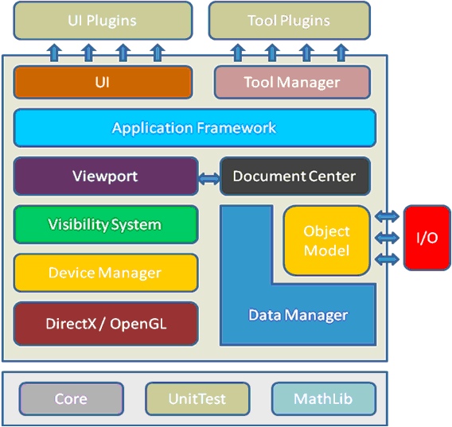
Application Structure

Slide 20

Kernel
提供最核心的代码和算法
  Many kinds of Manager
  Math library
  Unit testing support

Slide 21
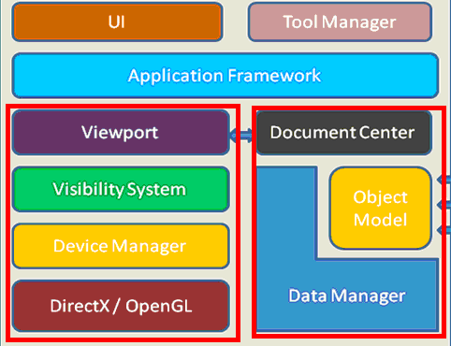
Components
UI framework
Tools
Framework
Rendering System
Data System

Slide 22
Plugins
UI Plugins
  For all ui components
    Properties
    Animation structure
Tool Plugins
  Center
  Move
IO plugins

Slide 23
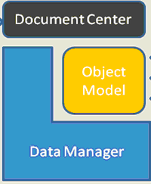
Data System Structure
Document Manager
Data Manager
Object Model

Slide 24
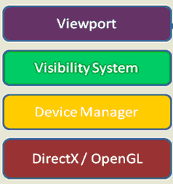
Rendering System Structure
Device manager
Visibility System
Viewport

Slide 25
Data Manager requirements
Low memory overhead. (tiny objects and properties)
Scalable when changing values. (move millions of objects at once in real-time)
Support animation and nested properties. (Properties that depend on other properties)
Allow assignment of properties to objects per view.
Be queriable.
Support asynchronous access.

Slide 26
Viewport
Selection System
Splite （分割）
嵌套

Slide 27
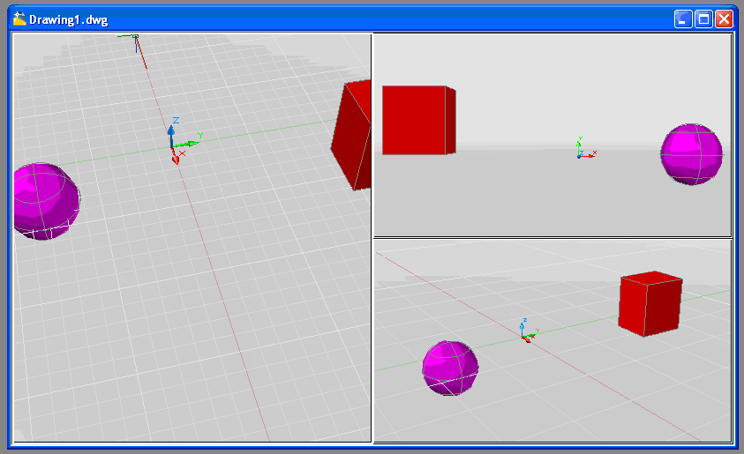
Viewport

Slide 28
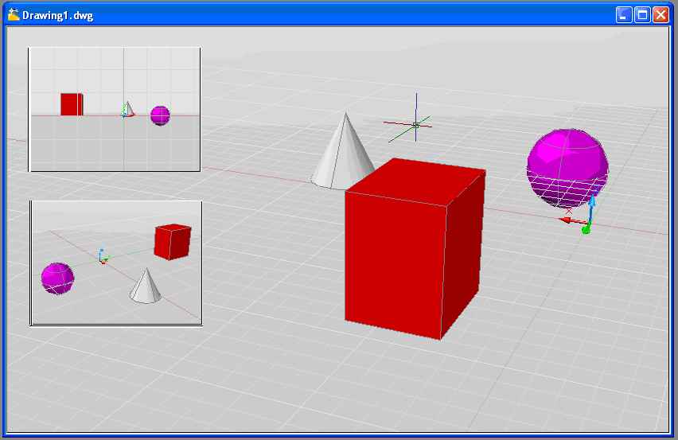
Viewport

Slide 29
Rendering System
Device Manager & visibility system
渲染系统最重要的部分，用于管理图形数据和渲染流程
Device Manager － 用于封装底层（DX，GL）的功能和数据结构
Visibility System － 实现各种快速渲染算法

Slide 30
渲染系统一些重要组成部分的简单介绍

Slide 31
Coordinate System
Math library
  Performance
Camera System

Slide 32
Primitives: (2D & 3D)
Geometry
  2D : line, Arc, Circle, Ellipse, NURBS …
  3D : sphere, box, shell …
NURBS & Polygonal Modeling (Maya)
  Geometry to Mesh (Triangle)
  Entity to NURBS

Slide 33
Text (2D & 3D)
Property
  Font
  Style
Rendering
  ID3DXFont
  GDI/GDI+
  ……

Slide 34
Rasterizer (Image)
Supporting format
Image的剪裁和叠加

Slide 35
Material
Color
  Four components
Light
  3 types and calculation
Texture
  Texture mapping mode

Slide 36
RenderState
Blending
  Color
  Alpha
Fog
Depth and Stencil testing
……

Slide 37
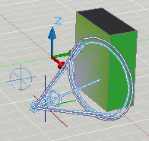
Widget
Compass（view cube）
Steeling wheel
Light direction
……

Slide 38
Printing
Target
  Printer
  XPS viewer
  file

Slide 39
Other Consideration
Temporary Graph
  Light Direction
Cutting Plane
Shadow
Markup
……

Slide 40
我们看一个实际的3D程序的渲染系统

Slide 41
AutoCAD渲染系统
优点：
  光照效果的充分使用
  方便性，易用
仍然有很多缺点,有待完善

Slide 42
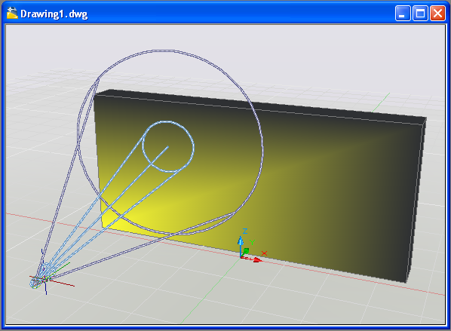
AutoCAD渲染系统
Light 使用固定管道

Slide 43
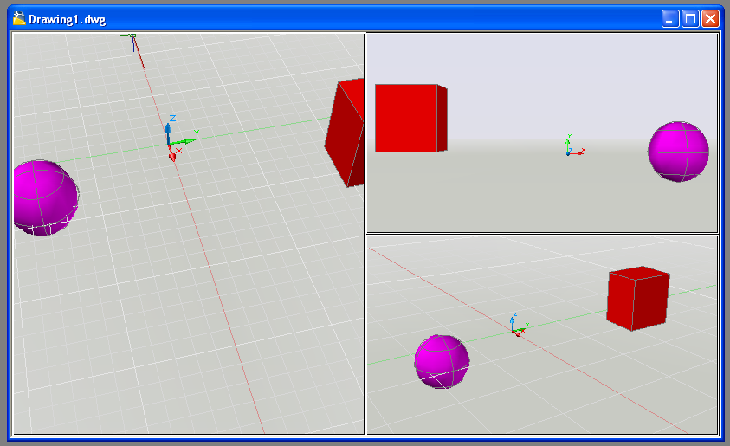
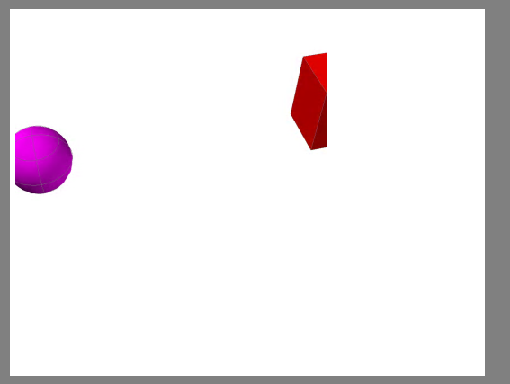
AutoCAD渲染系统
Viewport & Plot(print)

Slide 44
总结
从顶到底的基于渲染系统应用程序的动态结构分析和静态结构分析
具体渲染系统的实现内容在以后课程中介绍
渲染系统各个重要组成部分的简单介绍

